Slide 1
IHS/Tribal 638 Workshop
New Mexico Medicaid
Conduent
Government Healthcare Solutions

Slide 2
Purpose
The purpose of this workshop is to provide an overview on verifying eligibility, submitting claims, adjustments and voids using the New Mexico Medicaid Portal as well as discussing NM Medicaid policy and resources for IHS/Tribal 638 facilities.

Slide 3
Ways to Check Eligibility
On-Line Eligibility Inquiry—Web Portal: https://nmmedicaid.portal.conduent.com/static/index.htm
Automatic Voice Response System (AVRS) 800-820-6901
Conduent Eligibility Help Desk: 800-705-4452
Monday – Wednesday & Friday (Mountain Time) 8:00 a.m. - 5:00 p.m.
Thursday (Mountain Time) 8:00 a.m. - 4:00 p.m.

Slide 4
Medicaid Limited Benefit Categories of Eligibility
029: Family Planning Benefits
041: QMB - Age 65 and Over
044: QMB - Under 65
301: Pregnancy Related Medicaid
For a Categories of Eligibility (COE) & description listing, go to:
http://www.hsd.state.nm.us/uploads/files/Looking%20For%20Information/General%20Information/Rules%20and%20Statutes/Medical%20Assistance%20Division/MAD%20NMAC%20Eligibility%20Program%20Manual/Eligibility%20Pamphlets/EP%20revised%206_17.pdf

Slide 5
Claim Form Instructions
Conduent
Government Healthcare Solutions

Slide 6
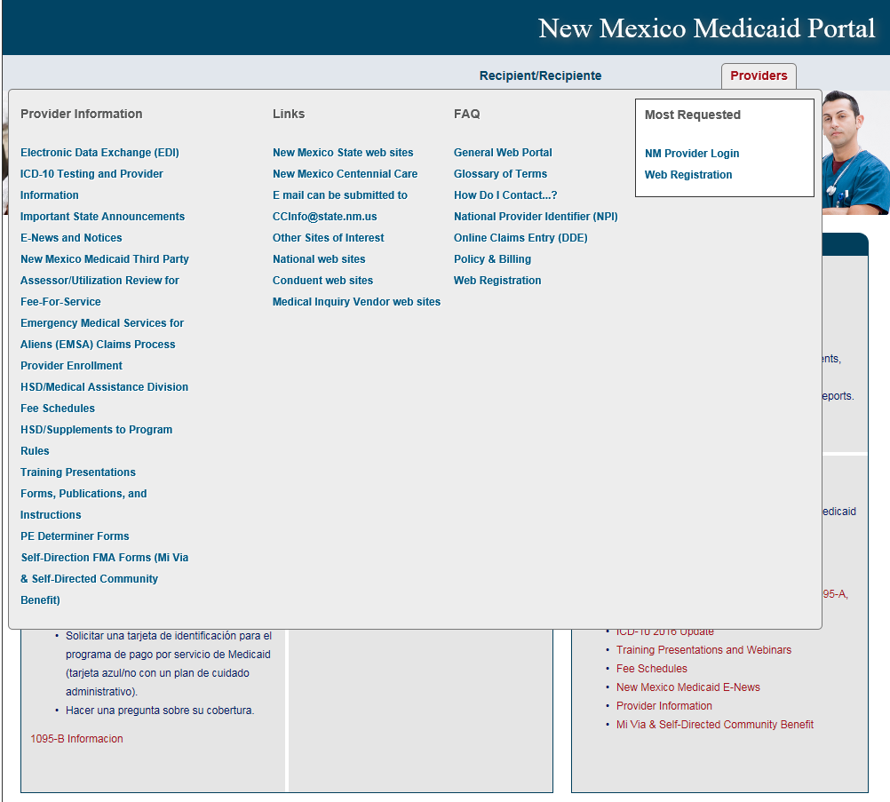
Where to get a copy of Claim Form Instructions
On the Portal: Click on Providers then Forms, Publications, and Instructions under Provider Information

Slide 7
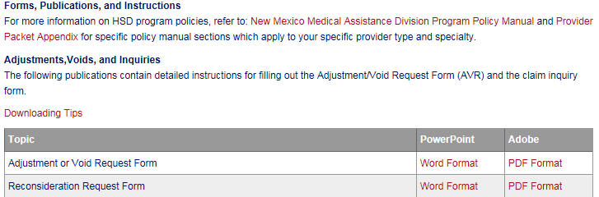
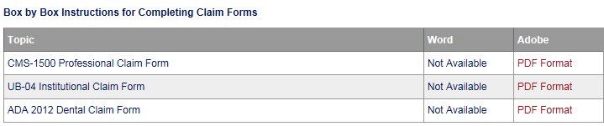
Where to get a copy of Claim Form Instructions
Scroll down
Open file

Slide 8
Medicaid Online Primary Claim Submission
Conduent
Government Healthcare Solutions

Slide 9
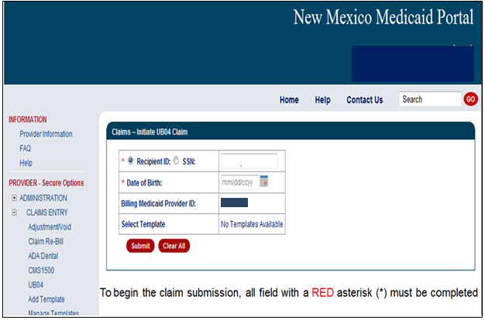
Online Claims Entry
Your Provider Info will populate here
Your Provider ID

Slide 10
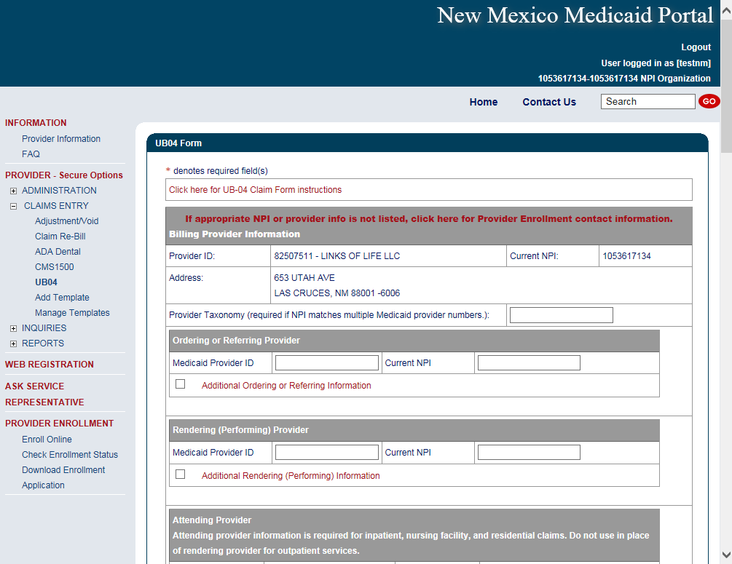
Online Claims Entry Primary Claim Continued
Your Provider Info will populate here
Click on the Red Text for the UB-04 Claim form instructions

Slide 11
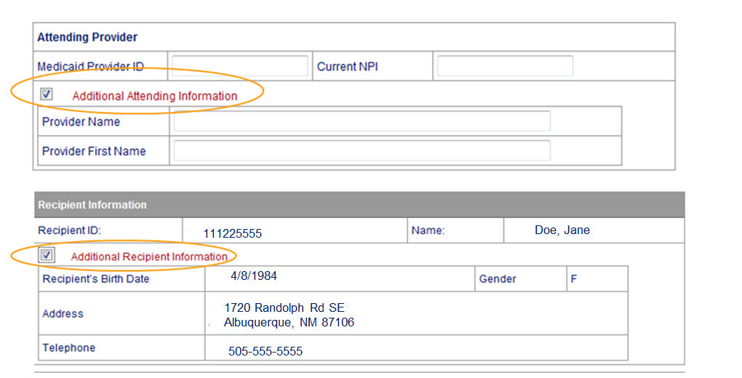
Additional Information Option Continued
Sections can be expanded by selecting all sections with Red Text

Slide 12
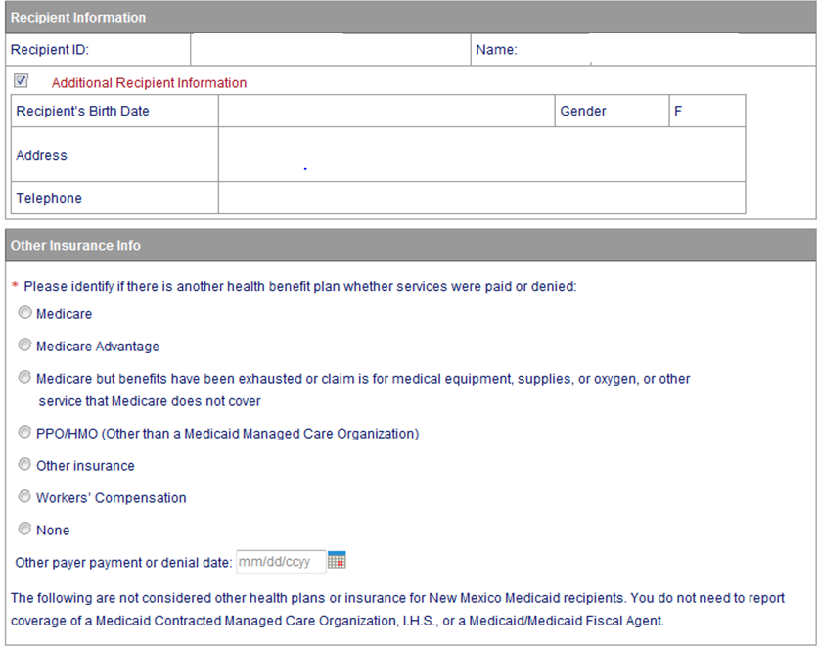
Online Claims Entry Primary Claim Continued
Sections can be expanded by selecting all sections with Red Text

Slide 13
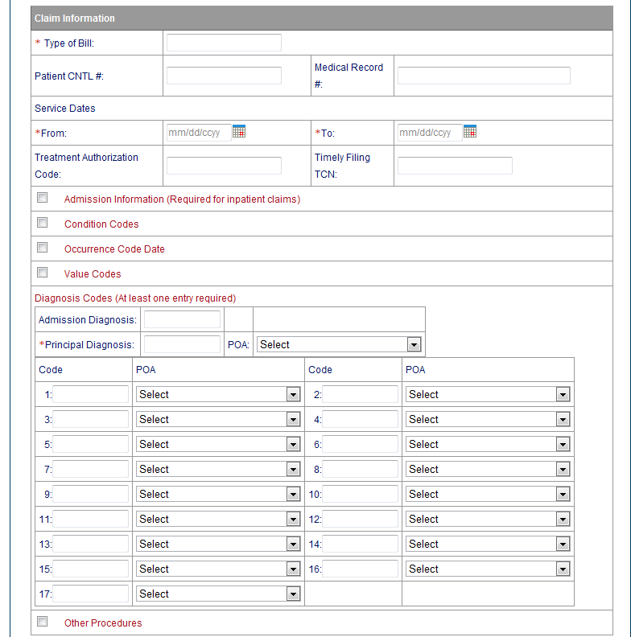
Online Claims Entry Primary Claim Continued
Sections can be expanded by selecting all sections with Red Text
Decimal point is not required for diagnosis. Using a decimal point will result in the error message below.
“Diagnosis Code (1-17) does not allow decimals”
Note: The web portal has been formatted to allow 12 diagnosis codes which matches the CMS-1500. UB-04 allows for 17 diagnosis codes.

Slide 14
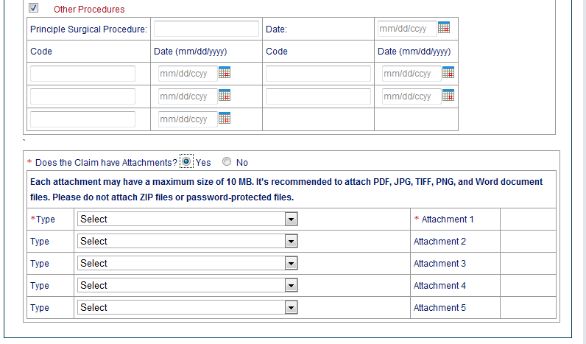
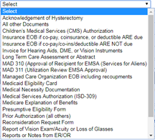

Online Claims Entry -- Attachments
Click upload

Slide 15
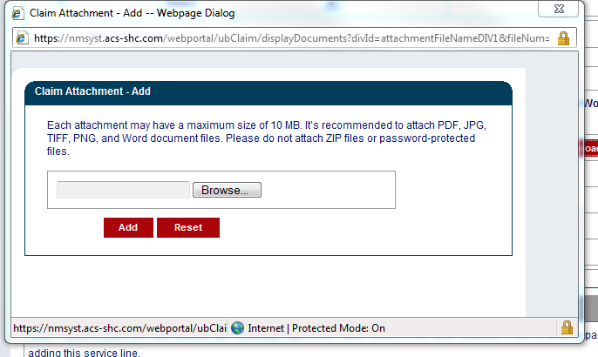
Online Claims Entry – Attachments Continued
Review the Uploading Attachments Restrictions.
Note: You can attach files up to 10 MB
Do not upload ZIP Files, Excel Spreadsheets or Password Protected Files.

Slide 16
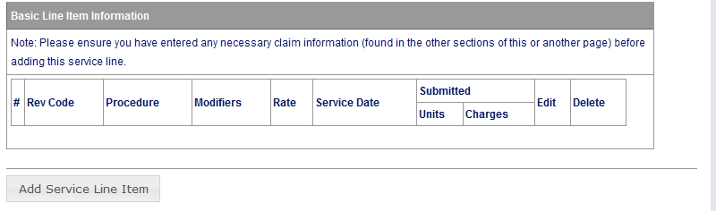
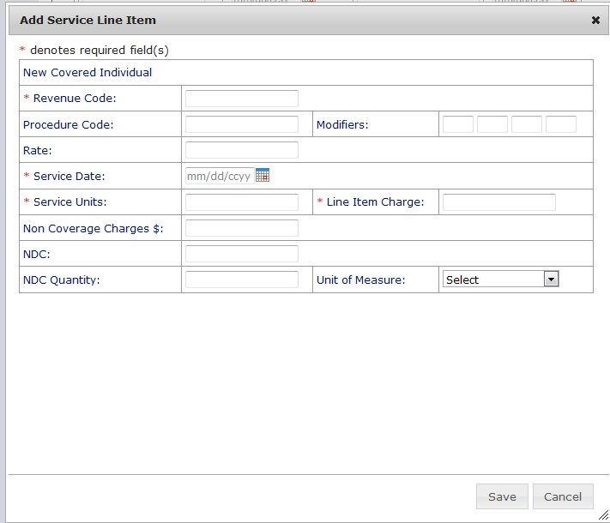
Online Claims Entry Primary Claim Continued
All fields with a Red Asterisk (*) are REQUIRED fields
Diagnosis codes do not require a period(.)
Only enter the numeric value

Slide 17
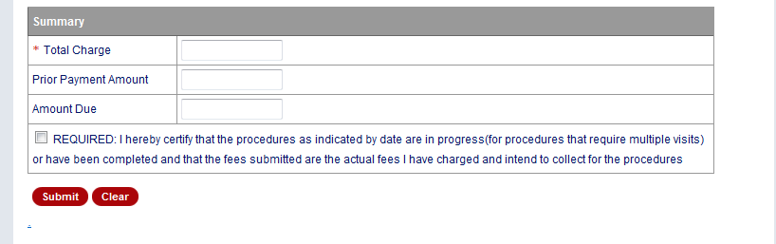
Online Claims Entry Primary Claim Continued
Indicate the Total Charge
x
Verify Total Charge is correct
If Total charge is missing or does not match up with the line item provided on the claim, the claim will deny or post additional edits.

Slide 18
Medicaid Third Party Liability (TPL) Claim
Conduent
Government Healthcare Solutions

Slide 19
Third Party Liability (TPL) Tips
TPL is commercial insurance
TPL must be billed primary to Medicaid unless it is a tribal self insured policy
Medicaid does not consider Medicare TPL
Continued on next page . . .

Slide 20
Third Party Liability (TPL) Tips Continued
Attach the TPL EOB showing the payment/denial with the claim.
Always include the explanation page of the EOB along with the page of the EOB that shows payment/denial.

Slide 21
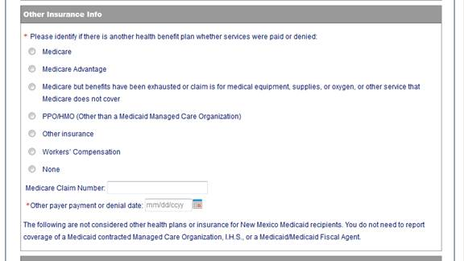
Third Party Liability (TPL) Continued
When filling out a Medicaid claim indicate whether the Primary Insurance us a PPO/HMO or other insurance by selecting the appropriate option
When filling out a Medicaid claim where TPL is primary payer, be sure to fill in all required primary and secondary payer information

Slide 22
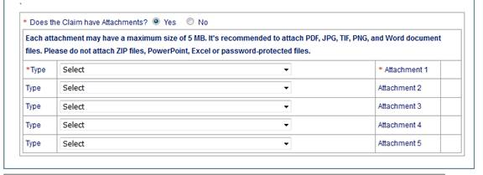
Third Party Liability (TPL) Continued
Attach a copy of the EOB
along with the explanation
of denials page

Slide 23
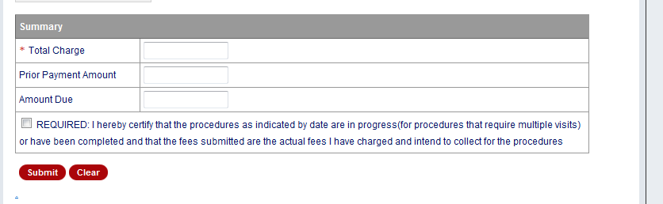
Third Party Liability (TPL) Continued
Indicate the Total charge or OMB rate
TPL Payment
x
Difference between Total charge and TPL Payment
Verify Total Charge is correct, If total charge is missing or does not match up with the line item provided on the claim, the claim will deny or post additional edits.

Slide 24
Medicare Primary Claims (Crossovers)
Conduent
Government Healthcare Solutions
Notes:
Same process for Medicare Replacement Plan.

Slide 25
Medicare Primary Claims Continued
Indicate “Medicare” for Medicare Crossover submissions
Continued on next page . . .

Slide 26
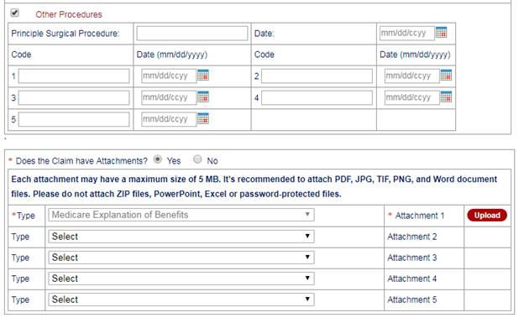
Medicare Primary Claims Continued
Attach a copy of the EOB
along with the explanation
of denials page
Continued on next page . . .
Notes:
Speaker Notes: If Medicare is primary, then first attachment will default to “Medicare Explanation of Benefits”

Slide 27
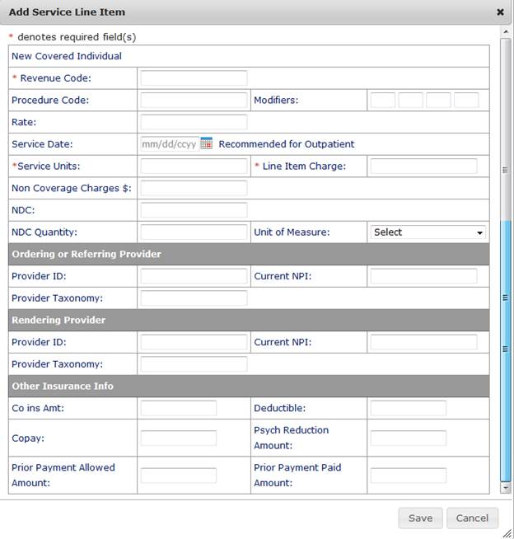
Medicare Primary Claims Continued
Other Insurance Information can be input at the line item level here

Slide 28
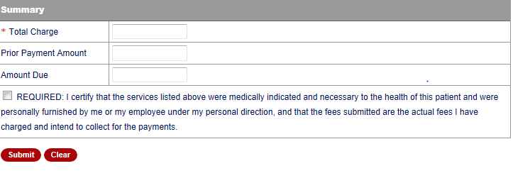
Medicare Primary Claims Continued
Indicate Total charge for Medicare primary claims
Leave the Prior Payment Amount blank
Co-Pay, Deductible and Co-Insurance Amount
X
Box must be populated in order for claim to be submitted

Slide 29
Inpatient Claims for Medicare Part B Only Clients
Conduent
Government Healthcare Solutions

Slide 30
Inpatient Claims for Medicare Part B Only Clients Continued
Certain Medicaid/Medicare clients only have Medicare Part B coverage. Medicare may cross over the Part B claim with type of bill 121. The Crossover claim does not have an accommodation revenue code on it. The claim will deny and the provider will need to resubmit and include the following on the claim:
  Use type of bill “121”
  Attach a copy of the EOMB indicate Medicare paid amount in previous payment box.
Continued on next page . . .

Slide 31
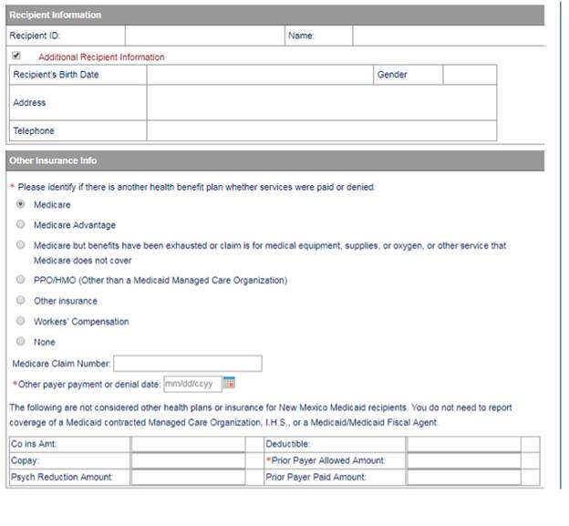
Inpatient Claims for Medicare Part B Only Continued
Indicate “Medicare” for Inpatient Claims for Medicare Part B Only Recipients
Continued on next page . . .
Notes:
Speaker notes: Recipient Information up top will be populated when billing the claim

Slide 32
Inpatient Claims for Medicare Part B Only Continued
Attach Copy of EOB
Continued on next page . . .
Notes:
Speaker Notes: If Medicare is primary, then first attachment will default to “Medicare Explanation of Benefits”

Slide 33
Inpatient Claims for Medicare Part B-Only Continued
Other Insurance Information can be input at the line item level here

Slide 34
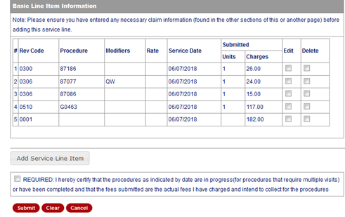
Inpatient Claims for Medicare Part B-Only Continued
X

Slide 35
Multiple Encounters
Conduent
Government Healthcare Solutions

Slide 36
Multiple Encounters
An encounter is a face-to-face visit between a client and an IHS provider. Multiple encounters can occur on the same date of service when the services are distinct.
The following are billable revenue codes:
0510 – Medicare Primary
0512 – Dental
0519 – Outpatient Physical Health
0529 – FQHC
0919 – Behavioral Health
Notes:
Speaker Notes:
http://www.hsd.state.nm.us/uploads/files/Providers/New%20Mexico%20Administrative%20Code%20Program%20Rules%20and%20Billing/NMAC%20Program%20Rules/Chapter%20310/8_310_12.pdf
(1) Encounters and visits at the same facility, on the same day, for the same or related diagnosis constitutes a single visit.
(2) Multiple encounters can occur on the same date of service. The following are examples of types of separate encounters:
(a) an eligible recipient receives a service that is not associated with the initial encounter and the service provided is for a different principal diagnosis; or
(b) an eligible recipient has the same diagnosis and is seen at two different facilities (different provider numbers) and one of the facilities is unable to provide the necessary services for the diagnosis or treatment of the eligible recipient’s condition.

Slide 37
Multiple Encounters Continued
More than one OMB charge can be billed in a day if the recipient:
  has different distinct services such as going to a dentist then to an eye exam on the same day.
  goes a second time to the same facility on the same day with a different diagnosis.
  was seen for a condition and returned the same day due to condition progression.
Notes:
Speaker Notes: More than one OMB charge can be billed in a day if the recipient has different distinct services such as going to a dentist then to an eye exam on the same day or goes a second time to the same facility on the same day with a different diagnosis or if a condition the patient was seen for earlier in the day has
More than one OMB charge can be billed in a day if the recipient has different distinct services such as going to a dentist then to an eye exam on the same day or goes a second time to the same facility on the same day with a different diagnosis or if a condition the patient was seen for earlier in the day has progressed.

Slide 38
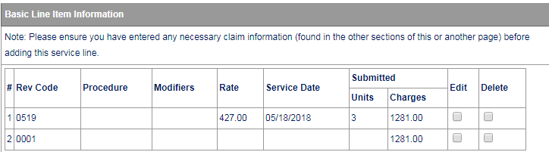
Billing Up to Three Encounters on the Same DOS

Slide 39
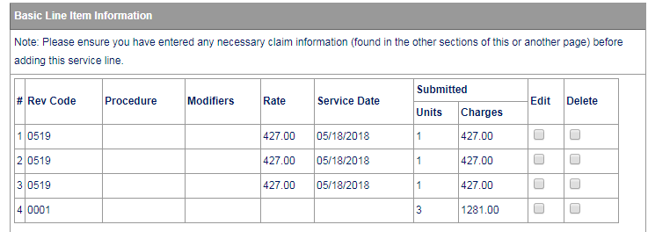
Billing Three Individual Lines

Slide 40
Outpatient Services Billed on CMS-1500
Conduent
Government Healthcare Solutions

Slide 41
Outpatient Services
Some services are not part of the OMB rate and are billed on the CMS 1500 form and reimbursed at the fee schedule rate.
Ambulatory surgical center facility services (ASC)
Anesthesia (professional charges)
Targeted case management
Hearing aids (hearing testing is reimbursed at the OMB rate)
Physician inpatient hospital visits and surgeries
Smoking cessation
Telehealth charge (telemedicine - HCPC code Q3014 (SEC 8.310.12.12))
Transportation claims are paid at transportation rates
Vision appliances - frames, lenses, dispensing glasses, contacts, etc. (The exam is in the OMB rate which is billed separately.)
Pharmacy claims which are billed as a pharmacy transaction rather than the CMS 1500

Slide 42
Outpatient Services Continued
Note that it is incorrect to bill laboratory codes, radiology codes, physician office visit codes, and physician emergency room codes as additional lines on the claim with the OMB revenue codes.
Note that the OMB rate can be billed when the physician is supervising the RN or LPN and signs the medical record (including after a nurse provides an EPSDT screening, or reviews a radiology image taken by a technician).

Slide 43
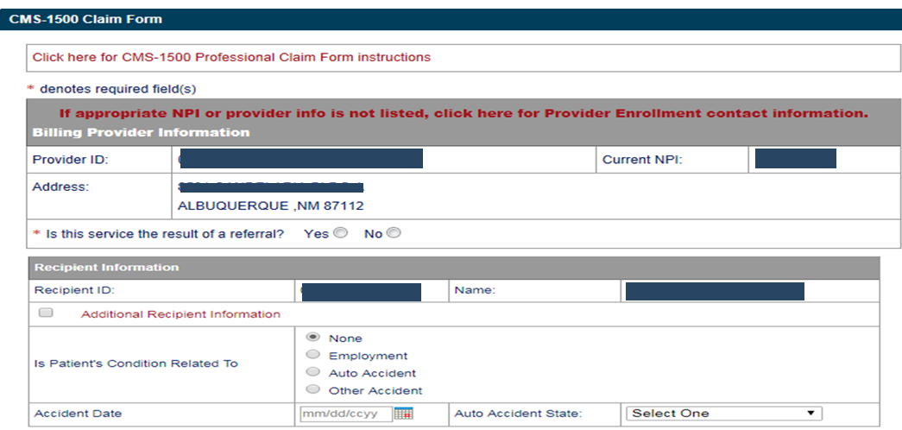
Online Claims Entry for CMS-1500
Click on the RED text for the CMS 1500 Claim form instructions

Slide 44
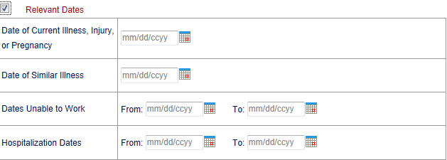
Online Claims Entry for CMS-1500 –Relevant Dates
Expanded ‘Relevant Dates” Section

Slide 45
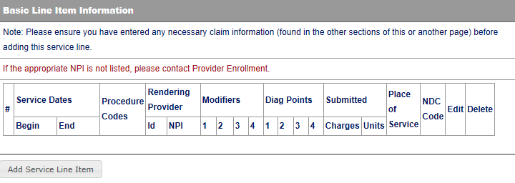
Online Claims Entry for CMS-1500 – Line Item Information
Click to add Line Items
Continued on next page . . .

Slide 46
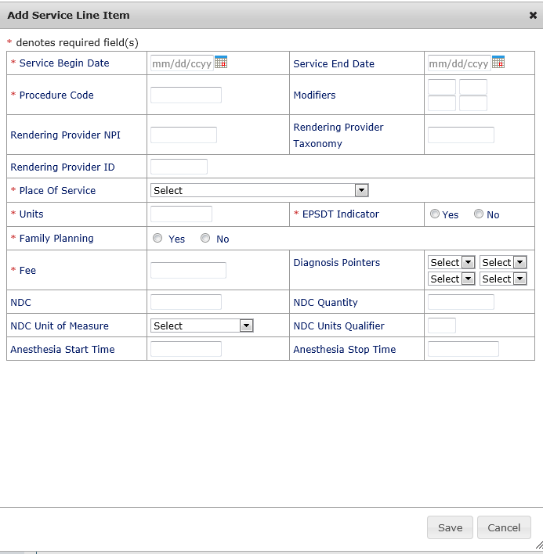
Online Claims Entry CMS-1500 – Line Item Information Continued
The fields with a red Asterisks (*) are REQUIRED

Slide 47
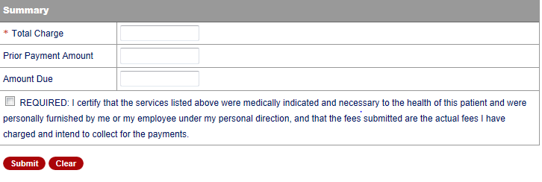
Claim Summary
Indicate the Total Charge
X
Box must be populated in order for claim to be submitted

Slide 48
Did you remember?
Ensure the line item charges are correct and match the total charge.
Include all appropriate EOB’s for TPL, HMO, Medicare, etc.
Rev codes, diagnosis codes, etc., are entered correctly.

Slide 49
Adjustments, Voids and Claim Re-Bills
Conduent
Government Healthcare Solutions

Slide 50
Definitions of Adjustments, Voids and Claim Re-Bill
Adjustments – for changes or updates to previously paid claims.
Voids – paid claims that need to be FULLY recouped.
Re-Bill – denied web portal submitted claims that can be resubmitted with corrected information in order for the claim to pay.

Slide 51
Adjustments Online
Conduent
Government Healthcare Solutions

Slide 52
Adjustments Online Continued
A paid claim CAN be adjusted
Claims that have been processed originally via Online Claims Entry are the ONLY claims that CAN be adjusted online. Online Claim TCNs begin with a “9”
Attach any new attachments pertinent to the adjustment
Denied claims CANNOT be adjusted
Claims processed via EDI or paper claims CANNOT be adjusted on the web portal
Continued on next page . . .

Slide 53
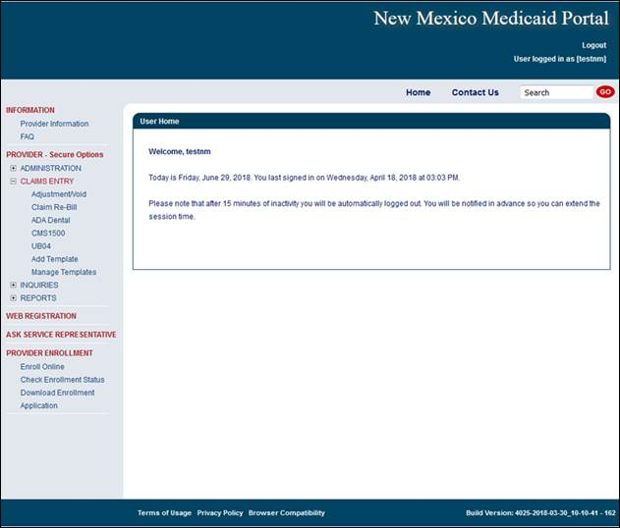
Adjustments Online Continued
Select Claims Entry tab then click Adjustment/Void

Slide 54
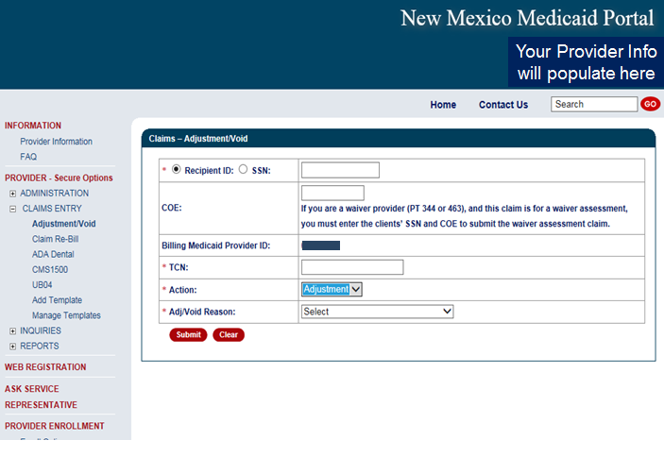
Adjustments Online Continued
Enter Recipient ID, TCN of claim that needs to be adjusted, select “Adjustment” as the Action item, and the select the reason for your adjustment.

Slide 55
UB-04 Adjustments Online
Conduent
Government Healthcare Solutions

Slide 56
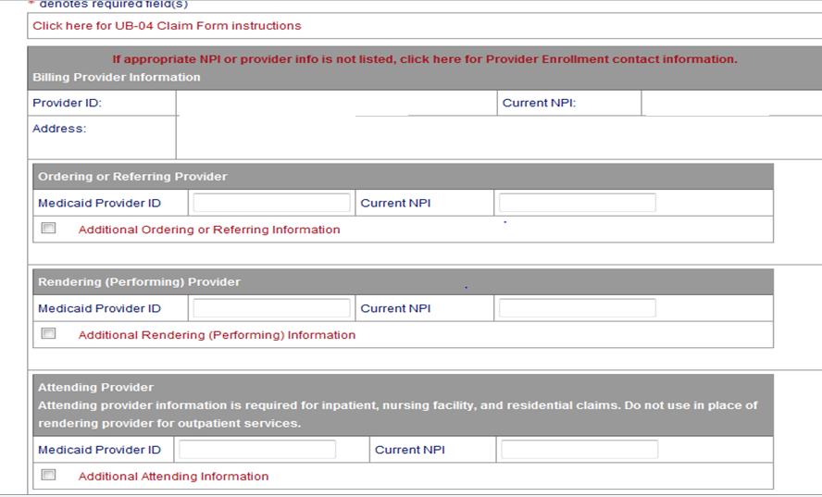
UB-04 Adjustments Online Continued
All data associated with the previously submitted TCN will auto-populate
Make any changes to the existing information provided

Slide 57
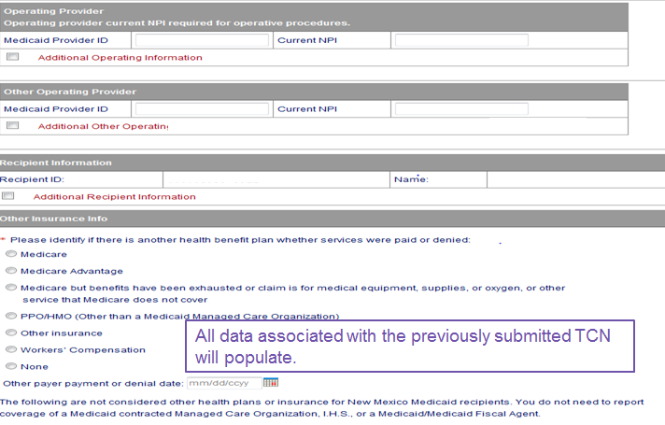
UB-04 Adjustments Online Continued
All data associated with the previously submitted TCN will auto-populate
Make any changes to the existing information provided

Slide 58
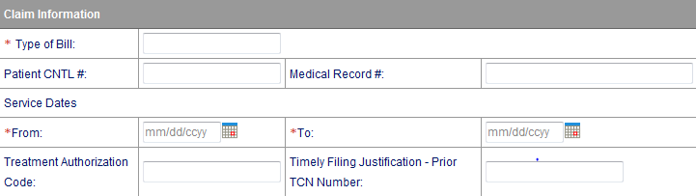
UB-04 Adjustments Online Continued
All data associated with the previously submitted TCN will auto-populate
Make any changes to the existing information provided
Indicate Timely Filing Justification TCN provided in the claim information section

Slide 59
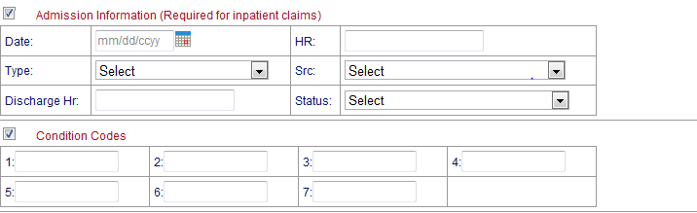
UB-04 Adjustments Online Continued
All data associated with the previously submitted TCN will auto-populate
Make any changes to the existing information provided

Slide 60
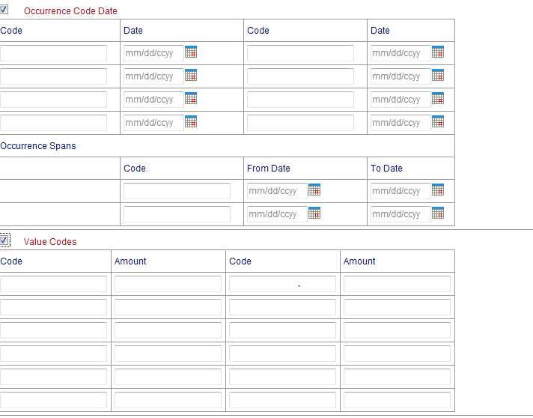
UB-04 Adjustments Online Continued
All data associated with the previously submitted TCN will auto-populate
Make any changes to the existing information provided

Slide 61
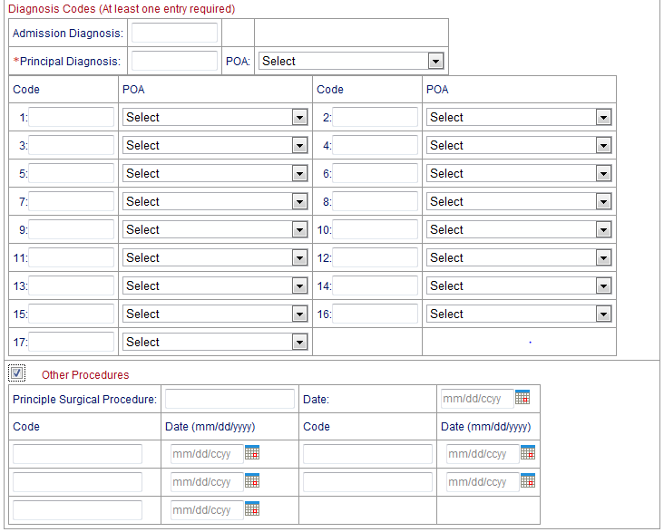
UB-04 Adjustments Online Continued
All data associated with the previously submitted TCN will auto-populate
Make any changes to the existing information provided

Slide 62
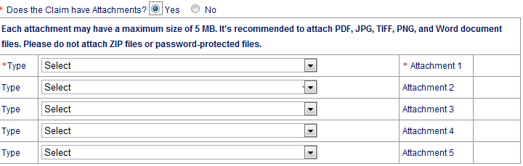
UB-04 Adjustments Online Continued
All data associated with the previously submitted TCN will auto-populate
Make any changes to the existing information provided

Slide 63
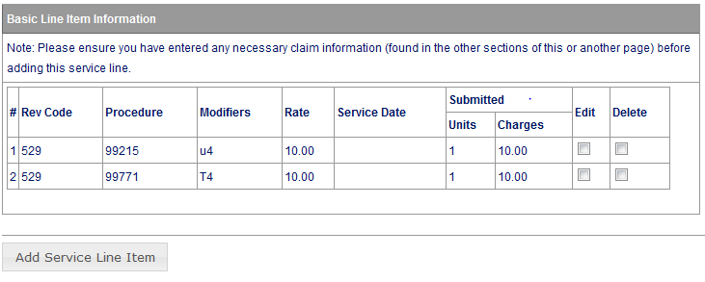
UB-04 Adjustments Online Continued
All data associated with the previously submitted TCN will auto-populate
Make any changes to the existing information provided
To add additional line items, select “Add Service Line Items”
Select “Edit” to make changes to lines already populated.

Slide 64
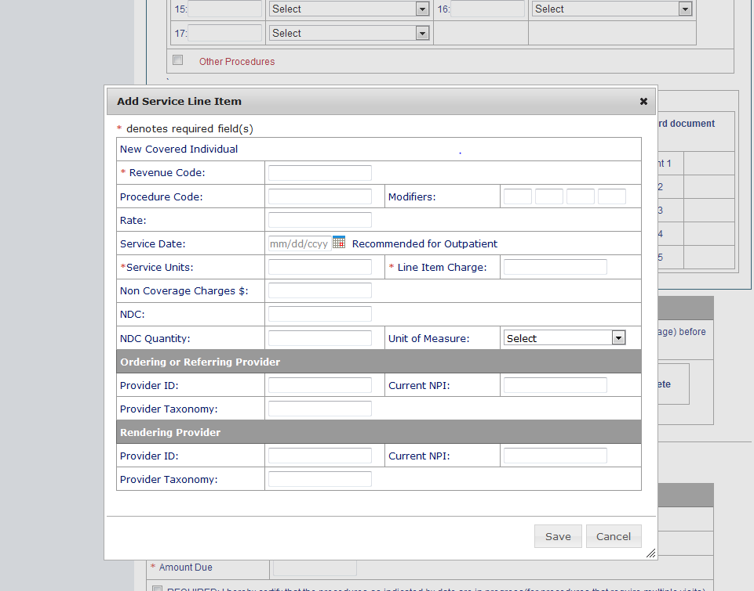
UB-04 Adjustments Online Continued
All data associated with the previously submitted TCN will auto-populate
Make any changes to the existing information provided

Slide 65
UB-04 Adjustments Online Continued
All data associated with the previously submitted TCN will auto-populate
X
Make any changes to the existing information provided
X
Once adjusted claim is submitted, a new TCN will be generated.

Slide 66
CMS-1500 Adjustments Online
Conduent
Government Healthcare Solutions

Slide 67
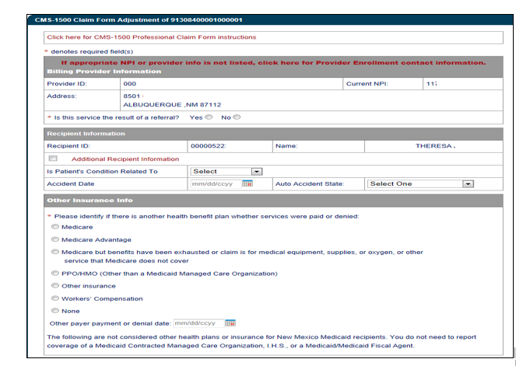
CMS-1500 Adjustments Online Continued
All data associated with the previously submitted TCN will auto-populate
Make any changes to the existing information provided

Slide 68
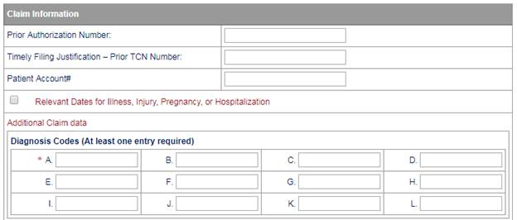
CMS-1500 Adjustments Online
All data associated with the previously submitted TCN will auto-populate
Make any changes to the existing information provided
Notes:
CMS allows 12 diagnosis codes

Slide 69
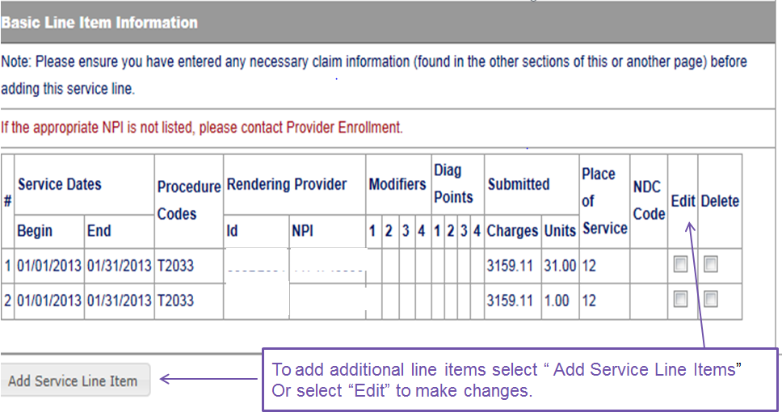
CMS-1500 Adjustments Online Continued
All data associated with the previously submitted TCN will auto-populate
Make any changes to the existing information provided
To add additional line items, select “Add Service Line Items”
Select “Edit” to make changes to lines already populated.

Slide 70
CMS-1500 Adjustments Online Continued
All data associated with the previously submitted TCN will auto-populate
Make any changes to the existing information provided

Slide 71
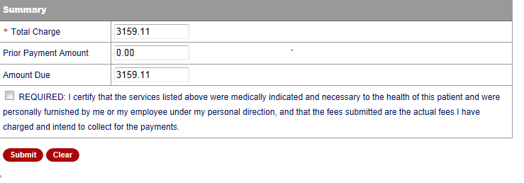
CMS-1500 Adjustments Online Continued
All data associated with the previously submitted TCN will auto-populate
X
Make any changes to the existing information provided
Once adjusted claim is submitted, a new TCN will be generated.

Slide 72
Voids Online
Conduent
Government Healthcare Solutions

Slide 73
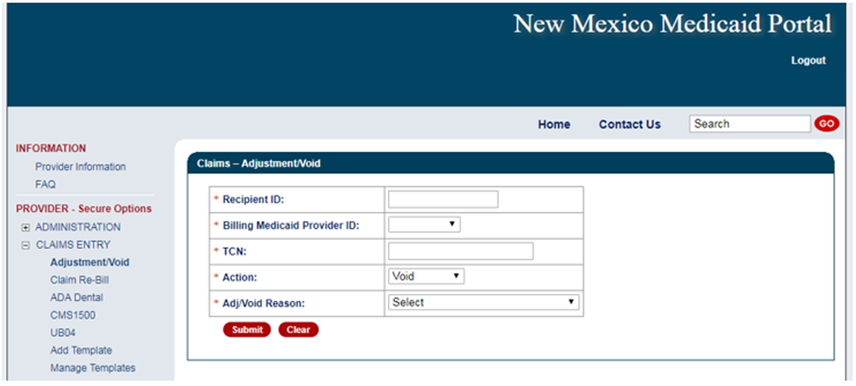
Voids Online Continued
Select Claims Entry tab then click Adjustment/Void

Slide 74
Voids Online Continued
Enter Recipient ID, TCN of claim that needs to be adjusted, select “Void” as the Action item, and the select the reason for your adjustment.

Slide 75
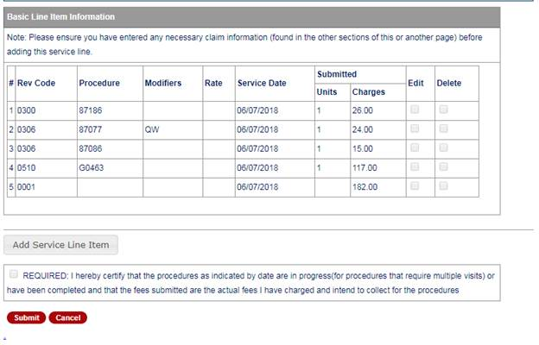
Voids Online
Once the voided claim is submitted, a new TCN will be generated.
Notes:
Speaker Notes: . For a void, user only needs to click Submit. The “Required” field will be grayed out (like all other fields on the void).

Slide 76
Claim Re-Bill
Conduent
Government Healthcare Solutions

Slide 77
Claim Re-Bill Continued
  All data associated with the previously submitted TCN will auto-populate
  Make any changes to the existing information
  Once claim you would like to re-bill is submitted, a new TCN will be generated
  The new TCN will show the claim to be in the ‘O-To Be Paid’ status once the re-bill is correctly submitted.

Slide 78
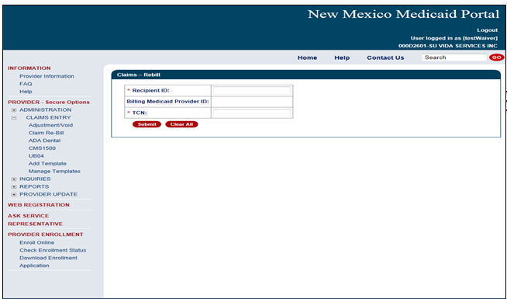
Claim Re-Bill
Enter Recipient ID, Billing Provider ID, and previously denied TCN then Submit

Slide 79
Paper Adjustment / Void
Conduent
Government Healthcare Solutions

Slide 80
Paper Adjustment / Void Continued
New Mexico Medicaid has revised the Adjustment/Void Request Form to better assist providers and reduce the number of returns.
The Adjustment / Void Request Form have been consolidated into one form. Submission instructions for the revised Adjustment/Void Form are included on the form.
The form can be found on the New Mexico Medicaid Web Portal at:
https://nmmedicaid.portal.conduent.com/static/ProviderInformation.htm#FormsPubs
After October 1st, 2017, Conduent will no longer accept older versions of the Adjustment/Void Request Form and will return to provider.
Each Adjustment/Void request must be submitted with the form. Requests submitted without the form will be returned to the provider.

Slide 81
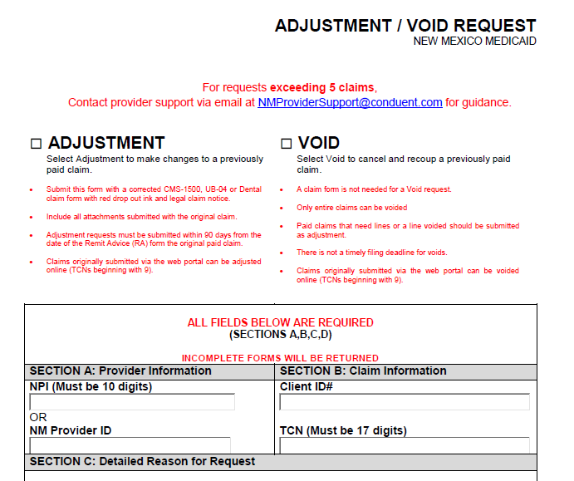
Paper Adjustment / Void Continued

Slide 82
Paper Adjustments / Void – Filing Guidelines
Complete Adjustment / Void form
A corrected claim is required for an Adjustment
Complete the corrected claim with all information as it was previously submitted, with the exception of the changes being made (only for an Adjustment Request)
Mail to:
  Conduent, LLC
  P.O. Box 26500
  Albuquerque, NM 87125

Slide 83
IHS Top 5 Denials
Conduent
Government Healthcare Solutions

Slide 84
IHS Top 5 Denials
IHS Denials are on a revolving monthly list. The top five (5) denials generally remain the same. Most of the denials revolve around Eligibility for the Client.

Slide 85
IHS Top 5 Denials Continued
Ranking Claim | Exception Code | Exception Code Description | Follow Up
1 | 0128 | Svc dates within Centennial Care Enrollment Period | Verify eligibility via the Web Portal
2 | 0143 | Client Not Eligible | Verify eligibility via the Web Portal
3 | 0029 | Svc not Family Planning | Verify eligibility via the Web Portal
4 | 1361 | Exact Duplicate | Verify if there are multiple encounters for the same DOS. If so, submit a Reconsideration Form
5 | 0900 | Mcare denied for Admin Rsns-not following billing requirement | Review Mcare Explanation of Benefits(EOB)

Slide 86
New Mexico Medicaid Resources
New Mexico Medicaid Online
  Provider Information
  Provider Login Screen Notices
  Provider E-News Newsletters
Medicaid Provider Relations Call Center
Provider Communication Updates
Provider Field Representative
Provider Webinars
Open Forums and Live Training Sessions

Slide 87
New Mexico Medicaid Resources Continued
New Mexico Medicaid Portal – https://nmmedicaid.portal.conduent.com/static/index.htm
Claim Inquiries, Eligibility Verification, Electronic Claim Submission, Provider Manuals, E-News
NM Health Care Authority – http://www.hca.nm.gov
Supplements, Memos, Provider Billing Packets and Policy
Medical Assistance Division – PE Program Staff – HSD.PEDeterminers@state.nm.us
Assistance with PE Applications, PE Determinations, MAD 070, PE Training, PE Certification
Consolidated Customer Service Call Center – (800) 299 - 7304
Claim Status, Eligibility, Prior Authorization, Medicaid Updates
Conduent Provider Relations Helpdesk – NMProviderSUPPORT@conduent.com
Claim research assistance and general Medicaid inquiries
Conduent HIPAA Helpdesk – HIPAA.DeskNM@hsd.nm.gov
Assistance on NM Web Portal, EDI inquiries, and Online Claim Submission with DDE (Direct Data Entry)
Conduent Provider Enrollment Helpdesk - NMProviderSUPPORT@conduent.com
Provider Enrollment Applications, Forms & Instructions
Medical Assistance Division, Program Rules – http://www.hca.nm.gov/providers/rules-nm-administrative-code/
NMAC for Programs administered by the Medical Assistance Division
Yes New Mexico - https://www.yes.state.nm.us/yesnm/home/index
Apply, check, update, or renew Medical Assistance (Medicaid) benefits

